Slide 1


NBS Projects in Schools

Slide 2
Natursekken

Slide 3



Natursekken
Professional and didactic guidance and funding.
Follow-up from the Norwegian Center for Science Education.
Regional contacts from institutions in the teacher-education programme.
Natursekken

Slide 4



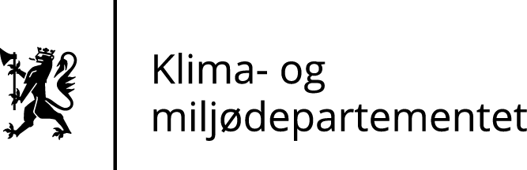

Natursekken
Notes:
The project is a collaboration between two ministries and two directorates.
(Pause: 1)
The ministry of Education and Research, and the ministry of Climate and environment.
The directorate of Education and Training and the Norwegian Environment Agency.

Slide 5
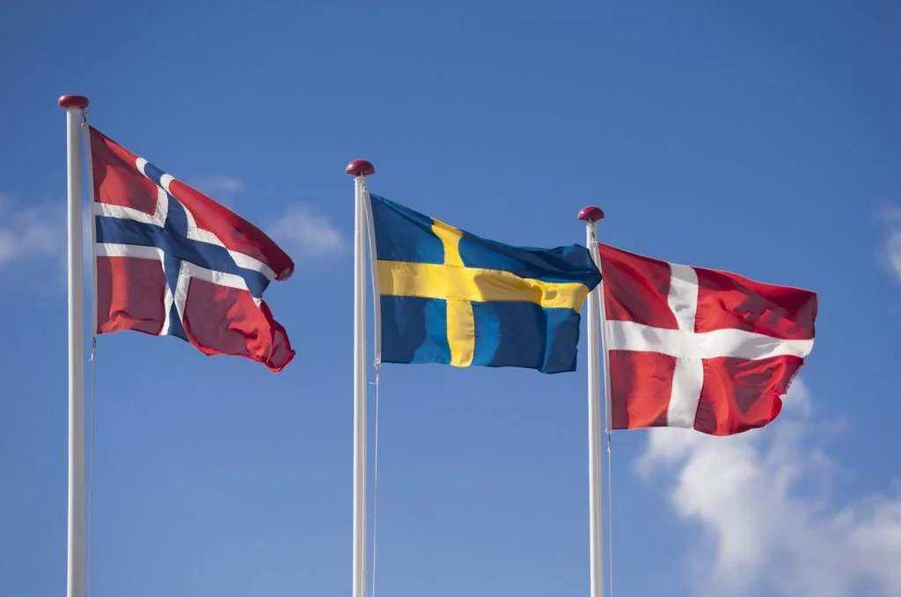
Nordic Cooperation
UN 2030 Agenda for sustainable development.
Sweden, Denmark and Norway.
Nordic model to increase competence.
Establish sustainable and practical programmes for the schools.
Natursekken
Notes:
Based on the UN 2030 agenda for sustainable development, teachers have been given the responsibility to ensure that school children and students acquire the knowledge necessary to ensure sustainable development. As a result of these new guidelines, a cooperation between Karlstad University and Umeå University in Sweden, Astra in Denmark, and the Norwegian Center for Science Education has been initiated.
(Pause: 1)
The goal is to design a nordic model to increase nordic teachers' competence for teaching sustainable development by implementing a teaching plan for sustainable development. The model is based on the didactic offer in the Sustainable Backpack, as well as experience and research from Denmark and Sweden. The teaching and projects are developed over three years, with the objective of establishing sustainable and practical programmes for the schools.

Slide 6
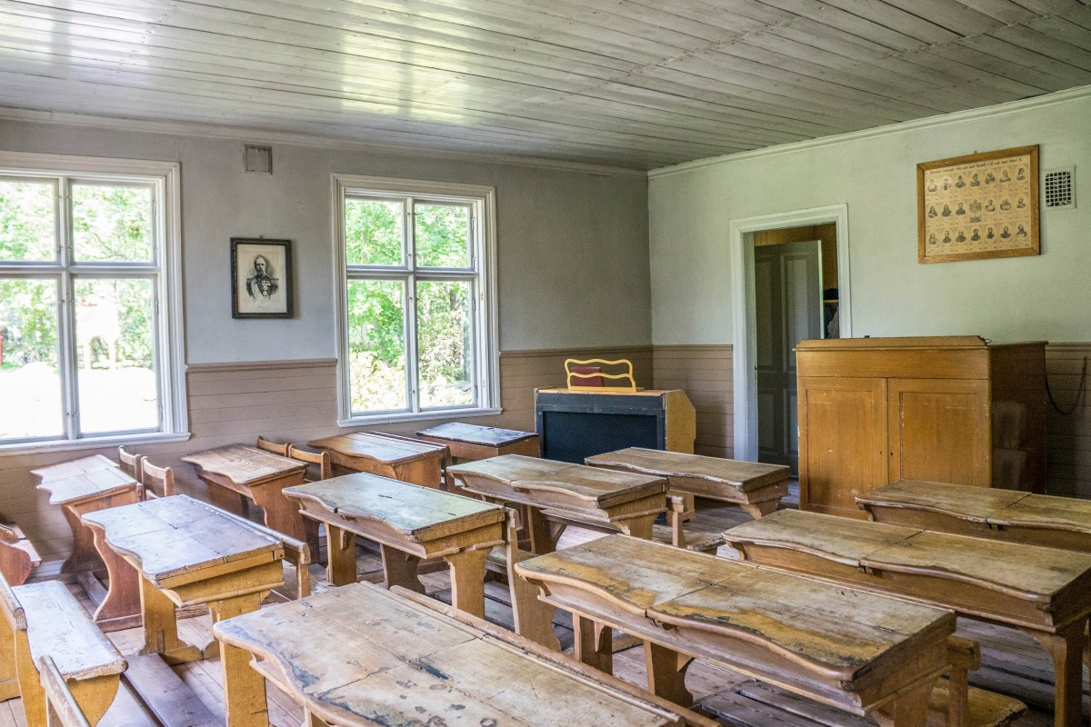
Project Implementation
Subject-dependent.
Primarily 1.-4th grade.
Natural science in all projects.
70% increase in use of the local environment.
40% increase in inquiry-based teaching.
Increased knowledge, attitude, and skill-set.
Natursekken
Notes:
Which projects will be implemented is largely up to each school to decide, depending on which subject they want to focus on; what resources are available in the area; and what projects would be relevant for the school. The majority of projects take place in the span of 1st to 4th grade, followed by 5th to 7th grade and 8th to 10th grade. Natural science education hosts the highest number of projects annually, and is closely followed by social sciences and Norwegian classes.
(Pause: 1)
Teachers reported a 70% increase in use of the local environment after implementing the sustainable backpack, and a 40% increase in inquiry-based teaching, and an overall increased knowledge, attitude and skill-set among the students.

Slide 7
Håkvik Skole
Helt Elektrisk / Completely Electric
Notes:
A project in Håkvik Skole focuses on hydropower.

Slide 8

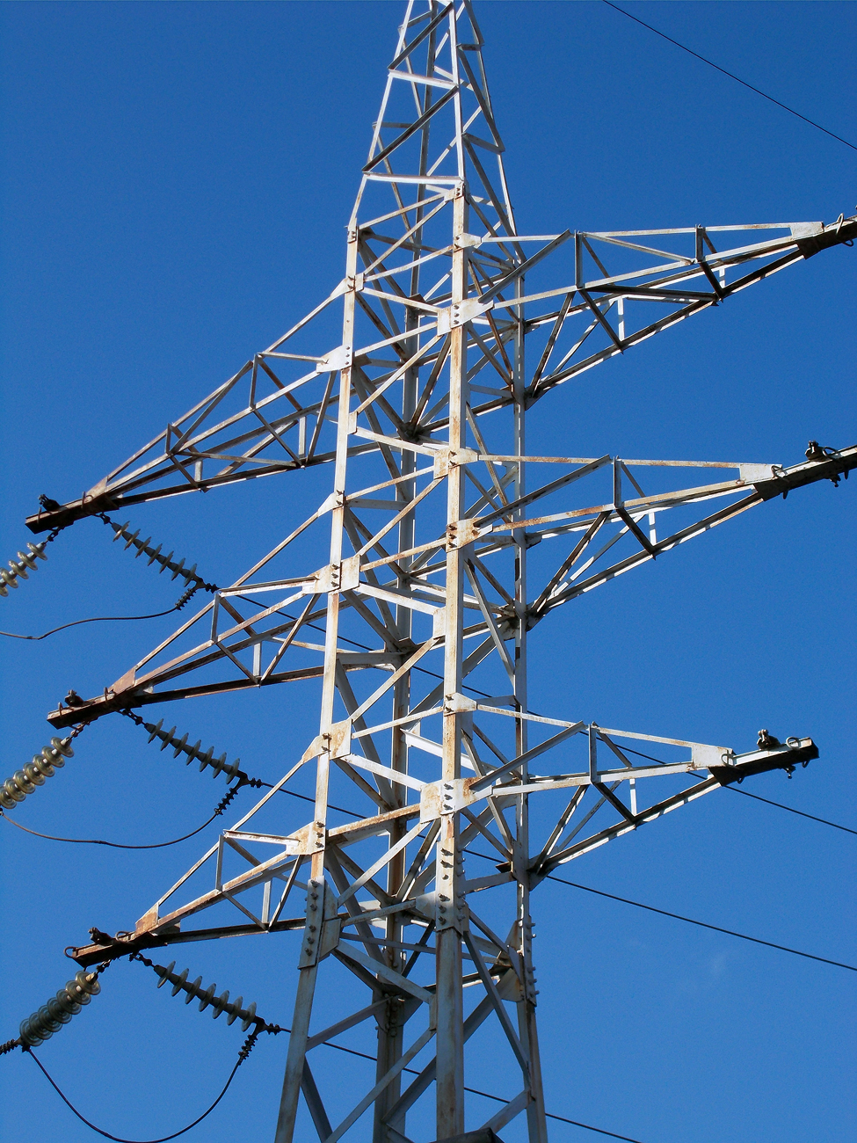
Central Actors
1st to 7th grade students, with teachers, at Håkvik Skole.
Nordkraft AS.
Ofoten Outdoor-Agency.
UiT.
Håkvik Skole
Notes:
Central actors in this project include the students from first to seventh grade, with teachers, at Håkvik Skole. However this project description takes base in the sixth grade implementation of the project. Additionally, the school benefitted from external actors such as Nordkraft AS, Ofoten Outdoor-Agency, and the University of Tromsø.

Slide 9
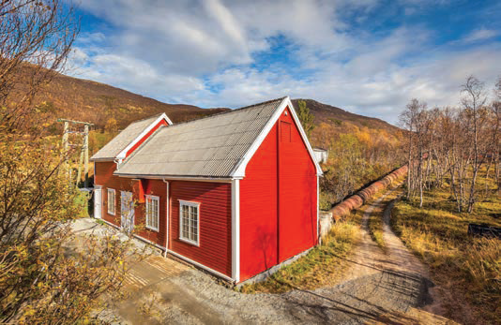
Project Goal
Energy production from water.
History, societal benefits, use of resources, sustainability.
Håkvik Skole
Notes:
The project objective was to teach the students about energy production from water both in a theoretical and practical sense. Additional focus included the history, societal benefits, use of resources, and sustainability of hydropower plants.

Slide 10

Project Description
Observation: Water stream, pipelines, foundations.
Hydropower museum.
Groupwork: Electrical circuits, wind power, pelton turbines, electrons in motion, calculating volume of pipelines, quizzes, relay.
Afterwork: Reports, presentations, evaluations.
Håkvik Skole
Notes:
In preparation for the project, the students were introduced to hydropower through educational videos and experiments on electricity. To kick-start the project, the students rode their bicycles towards the hydropower plant. On the first day the students stopped to observe water streams, pipelines, and foundation remaining from the initial hydropower plants. They camped outside in tents and discussed what they had observed the initial day. The following day the continued on their road towards the
(Voice: Ole)
Mølnfossen vannkraftmuseum,
(Voice: Karen)
the hydropower museum, while continuously reflecting on the effects hydropower development has on nature and society. At the museum, the students performed group work regarding closed electrical circuits, wind power, pelton turbines, electrons in motion, calculating the volume of the pipeline, quizzes, and they had a water-carrying relay.
After returning to the school grounds, the student wrote reports, and held presentations on what they had observed and learned from this field-trip. They also collectively evaluated the method of teaching. These teaching arrangements encompassed a number of subjects and allowed students to learn in a natural learning environment.

Slide 11
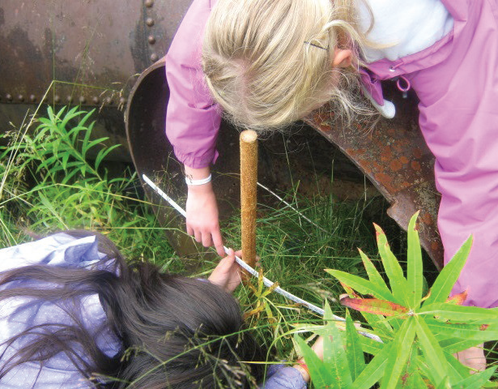
Benefits
First-hand witnessing the operation of hydropower plants.
Hydropower in context.
Interdisciplinary.
Håkvik Skole
Notes:
This project allowed the students to see first-hand how the hydropower plants operate. The visit to the museum also allowed them to understand the bigger context of hydropower, and therefore this project benefited from being an interdiciplinary project that included history, social studies, and mathematics. The students were thus able to put the operations in a wider context and use the things they learned in more than one subject.

Slide 12
Difficulties
Upgrade of the hydropower museum.
  Welcomed, well executed.
No significant challenges.
Håkvik Skole
Notes:
The primary difficulties that can be retrieved from this project may be the upgrade of the hydropower museum, however, this was welcomed and well executed. Other than this, there were no significant challenges.

Slide 13

Opportunities
Outdoor-teaching.
Practical activities.
Contextualized, promoting deeper understanding.
Local industries.
Håkvik Skole
Notes:
This project allows students to learn outside the classroom. Practical activities that are related to their subjects allows the students to bring the experience with them, and perhaps integrate what they learned in other arenas or subjects. This may also raise questions in later sessions and further promote a greater understanding of the local industry and its prospects.

Slide 14
Hegra Barneskole
Elva som pedagogisk ressurs /
The river as a pedagogical resource
Notes:
A project on the river as a resource.

Slide 15
Central Actors
1st to 7th grade students, with teachers, at Hegra Elementary School.
Stjørdal hunting- and fishing society.
NINA- Norwegian Institute of Natural Research.
Hegra History Society.
HiNT.
Hegra Barneskole
Notes:
The project involves 1st to 7th grade students and teachers of Hegra Elementary School, along with other stakeholders, including: Stjørdal hunting and fishing society, the Norwegian Institute of Natural Research, Hegra History Society, and HiNT (Høgskolen i Nord-Trondelag).

Slide 16
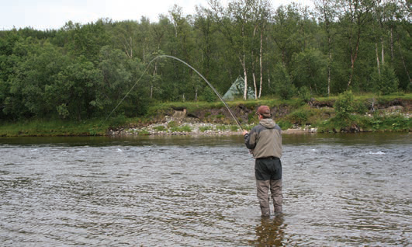
Project Goal
Utilize local resources.
Increase competence on sustainable development.
Theoretical knowledge by practical activities.
Interdisciplinary arena and curriculum.
Hegra Barneskole
Notes:
The project objective was to use local resources and areas to increase competence on sustainable development among the children, gaining theoretical knowledge by the means of practical activities. By utilizing interdisciplinary arenas and curriculum, the children will be actively engaged throughout the project execution.

Slide 17
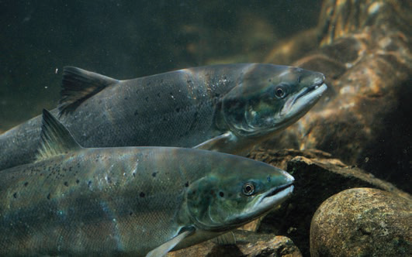
Project Description
Life of the wild salmon.
Fish farming.
Fish as food.
The looks, purpose, and use of the river.
Human impact, for better and for worse.
Why the river is as important as it is.
Hegra Barneskole
Notes:
The students were educated on different aspects of the river in a number of the included subjects. By including external actors, and simultaneously including the teacher in the education, the students witnessed first hand how exciting and useful the aspects of the river are. The teachers developed knowledge to use for further education of students on the topic.
Some points in which both students and teachers were educated:
The life of the wild salmon.
Fish farming.
Fish as food.
The looks, purpose, and use of the river.
Human impact, for better and for worse.
Why the river is as important as it is.
To reach the objectives set out in the project, the execution was very practical. For example, when learning about the salmon's spawning process, it was more useful to go outside and observe the spawning areas and roe, and directly improve the environment surrounding the spawning area. This provided the participants with the practical knowledge necessary and a specific activity for learning compared to reading about the spawning process.
The external actors provided the programme with expertise, historical background of the area, equipment necessary for fieldwork, and demonstration of activities. Additionally, by including external actors, the students reported that they found motivation in being somewhat equal to the teachers in the project. They enjoyed taking part in the creation of the teaching and having a right of co-determination in the project.

Slide 18
Benefits
Interdisciplinary.
Sense of achievement.
Witnessing positive developments.
From local to global.
Hegra Barneskole
Notes:
As an interdisciplinary project, the students were actively engaged in a number of subjects, allowing them to achieve deeper understanding and practical experience from the project. The students reportedly felt a sense of achievement, as the activities of improving the nearby environment fostered results in terms of increased spawning activity in the area. The students were able to see a positive development in their local area, while gaining an understanding that can be applied in the global arena.
Additionally, by including external actors, the students reported that they found motivation in being somewhat equal to the teachers in the project. They enjoyed taking part in the creation of the teaching and having a right of co-determination in the project.

Slide 19
Difficulties
Including external expertise.
  Demoted the teachers control of the project.
  Seen as a motivating factor.
Hegra Barneskole
Notes:
This project largely took advantage of external expertise, which demoted the teachers' control of the project. However, this has been one of the motivating factors for the students, which consequently encouraged the students during the project.

Slide 20
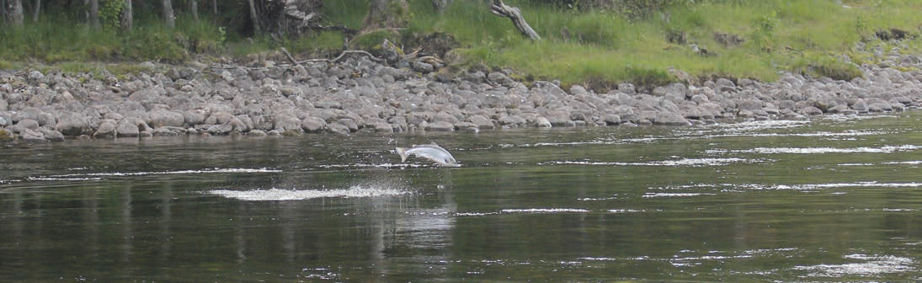
Opportunities
Including external actors.
Hegra Barneskole
Notes:
This project shows the benefits of including external actors in teaching projects.

Slide 21
Børsa Skole
Vannets kretsløp /
The water cycle
Notes:
Next is a project involving water cycles.

Slide 22
Central Actors
3rd grade school children, and teachers, at Børsa School.
Technical agency, Skaun municipality.
NTNU/HiST.
Børsa Skole
Notes:
Central actors in this project include third grade students and teachers at Børsa School. It also involves the technical agency of Skaun municipality and also NTNU together with HiST.

Slide 23
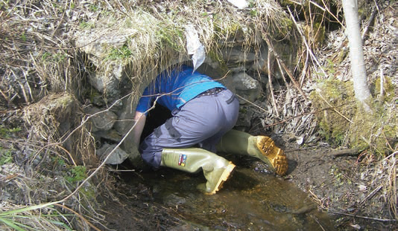
Project Goal
The cycle of water.
Interdisciplinary arenas and curriculum.
Børsa Skole
Notes:
The purpose of the project was to teach the children about the cycle of water, by investigating and observing a water stream that went past the school, further down to a river, and into the fjords. By utilizing interdisciplinary arenas and curriculum, the children will be actively engaged throughout the project execution.

Slide 24
Project Description
Exploratory terminology.
Water stream → river → fjord.
Mind-maps, experiments.
  Will the water in the fjords evaporate?
  Can we use all the water we want?
  What to do when we dont have access to water?
Comparing observations.
Børsa Skole
Notes:
Students were introduced to central exploratory terminology in the 2nd grade to prepare for practical implementation of the project “Vannets Kretsløp”. By the beginning of 3rd grade, the students were outside observing the initial water stream. The children discussed their observations, tasted the water, and collected plants and insects in the water stream area. The children followed the water stream to a nearby river, Brøselva, and did the same procedure as with the water stream: observed the water, tasted the water, and collected more plants and insects. after discussing the main similarities and differences between the two initial water sources, the children followed the river towards the nearby fjord. This water source was also tested in terms of taste, and they collected insects and plants, while comparing this to the prior water sources.
Back in the classroom, the children summarized their work and observations using mind maps. The following day they performed experiments using freshwater and saltwater, forming hypotheses on what would happen when boiling the different types of water, and tasting the water droplets that formed when boiling the water. The water was also boiled completely to see what would remain in the bottom of the pans. At the end of the projects the children discussed their thoughts on the project;
Will the water in the fjords ever evaporate?
Can we use all the water we want?
What would you do on a day when you have no access to water?
The children wrote stories about life without water, without clean water, and how to save water. Later, the children went back to the water sources to measure the temperatures and compare them. The project was finalized with a fundraising campaign to raise money to build wells in Mali to provide clean water.

Slide 25
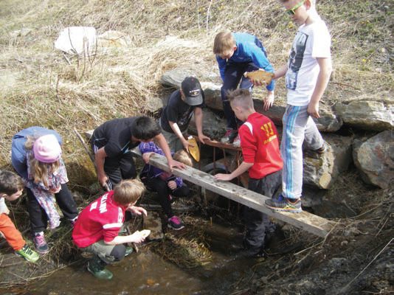
Benefits
Practical experience.
Individual impressions.
Further research.
Børsa Skole
Notes:
The children are left with practical experience of observing the cycle of the water sources around them. Each participant was left with individual impressions of the project, and when discussing a forgiving topic such as water with children, there are endless possibilities on where the conversation will go. The path was very much made up as they went along with the project, and consequently resulted in the children coming back to the topic on later occasions with new suggestions on what could be further researched.

Slide 26
Difficulties
Time consuming.
  Not necessarily an issue upon later projects.
Børsa Skole
Notes:
As the project came along with the execution, it did prove to be more time consuming than initially planned. However, as it was implemented once, this will not be an issue on later occasions.

Slide 27

Opportunities
Discuss impressions and observations.
Exploratory.
Reflect on personal use.
Børsa Skole
Notes:
The project implementation invites the children to converse on their impressions and observations. The structure is very exploratory, both in terms of conversation and activity. The children were able to portray their thoughts in the mind maps they created after the field-trip, and the discussions allowed the children to further reflect on their personal use of water, which can bring them towards the bigger picture on global water use and access.

Slide 28
Rognan Ungdomsskole
Artmangsføld på prøve /
Testing biodiversity
Notes:
This project in Rognan Ungdomsskole focuses on learning about biodiversity.

Slide 29
Background
Assumption that the species diversity among birds in the Fiskvågvannet nature reserve changed.
The main goal was to increase students' knowledge and understanding of sustainability
Management of our natural resources and give students a better basis for reflections on their own and society's role.
Notes:
The background for the project was the assumption that the species diversity among birds in the Fiskvågvannet nature reserve has changed in recent years. The main goal was to increase students' knowledge and understanding of sustainability
management of our natural resources and give students a better basis for reflections on their own and society's role.

Slide 30
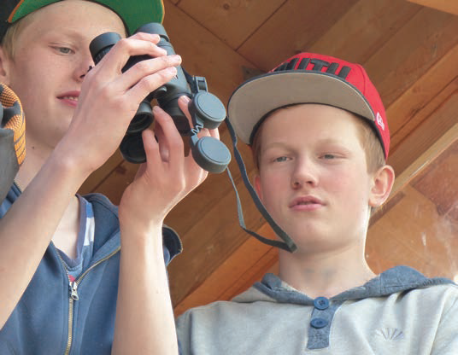
Project Description
- Students explored a nature reserve and observed certain bird species
- Students used binoculars, telescopes, wild cameras and digital cameras
- Students also used iPads with GPS to enter their observations.
→ Every registration of a bird was sent to the website miljolare.no. → Pictures of the cameras were sent to the teacher's phone
- In the classroom, students edited their results and published them online and in class
Notes:
Through exploring a nature reserve with using tools such as binoculars, GPS, and cameras, students can immerse themselves in adventure in nature and develop a deep understanding for biological diversity, habitat types, and sustainable development.

Slide 31
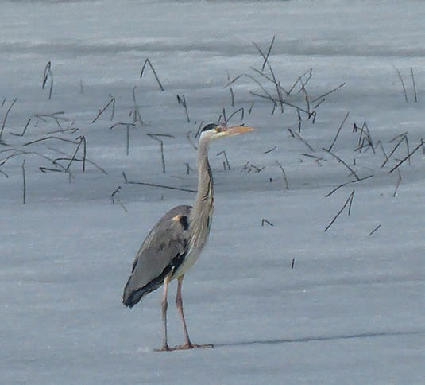
Project Description
- Theory was teached in class to develop a better understanding for sustainable development, biological diversity, habitat types and the protection of natural areas
- Students used the internet and literature to get to know the bird species
- Students used the application bird buddy.
- Students have learned the difference between the bird species
- Students learnt about the connection between the area management and species diversity
- Students compiled a species database where they should be able to see any changes in the species population over time.
Notes:
By learning theory and then seeing and exploring bird species in their habitats, students can have a first-hand understanding of biological diversity. Students also used the application “bird buddy” and they also got acquainted to bird songs which can help them identify the species.
Since this is a protected area, it was important to bring out the connection between the area management and species diversity.
The students compiled a species database where they should be able to see
any changes in the species population over time. The Norwegian Environmental Protection Agency contributed with a lecture where the students got an insight into the administration, and where they could ask relevant and clarifying questions.

Slide 32
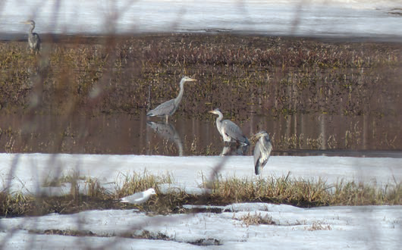
Project Reflections
Understanding of nature reserves and biological diversity.
Knowledge about how the bird life in a nature reserve is a dependent living environment under human influence
Opportunity to develop their ability to reflect on how
humans affect the living environment
Learnt about the importance of protecting nature
and biodiversity.
Gained experience with planning and carrying out fieldwork
Developed related skills
for observation, documentation, systematization and publication
Notes:
In this project, the students have gained an understanding of why it is necessary
to establish nature reserves and what significance these have
to maintain biological diversity. At the same time, the students have
gained knowledge about how the bird life in a nature reserve is a dependent living environment and the human influence on it.
By using a nature reserve in the local community, the students have
given the opportunity to develop their ability to reflect on how
humans affect the living environment and the importance of protecting nature
and biodiversity.
The students gained experience with planning and carrying out fieldwork and understanding for why they do this. They have developed related skillsfor observation, documentation, systematization and publication.

Slide 33
Risør Skole
Sunn, god og bærekraftig matlaging - forskerspirene lager mat fra fjæra
/ Healthy, good, and sustainable cooking - budding scientists make food from the shore

Slide 34
Participants
Risør primary school, grade 6
→ Collaboration with Norway HiT
Notes:
The project was implemented by the six graders of Risør primary school. Risør is a town in the south of Norway.
This project was supported by HiT, which stands for Høgskolen i Telemark (Telemark University College)

Slide 35
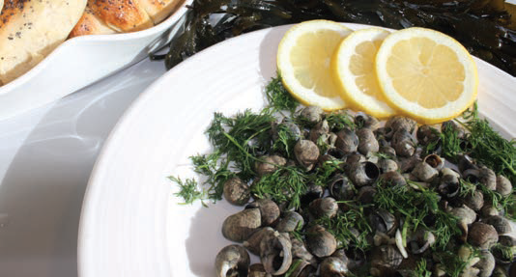
Background
Many unused resources in the sea that we can reap in a sustainable way.
Food made out of snails, seaweed, beach crabs, various shells and fish that are seen as “unfish”.
Students created a common cookbook .
Notes:
In this interdisciplinary project, students found local recipes that use raw materials from the sea that are largely not utilised in our days. e.g., snails, seaweed, beach crabs, various shells and fish that are seen as «unfish». The project will culminate in a common cookbook with recipes, species regulations, photos, maps, and historical stories about food from the sea. The project will provide students with versatile knowledge and experience of sustainable harvesting of resources in nature.

Slide 36
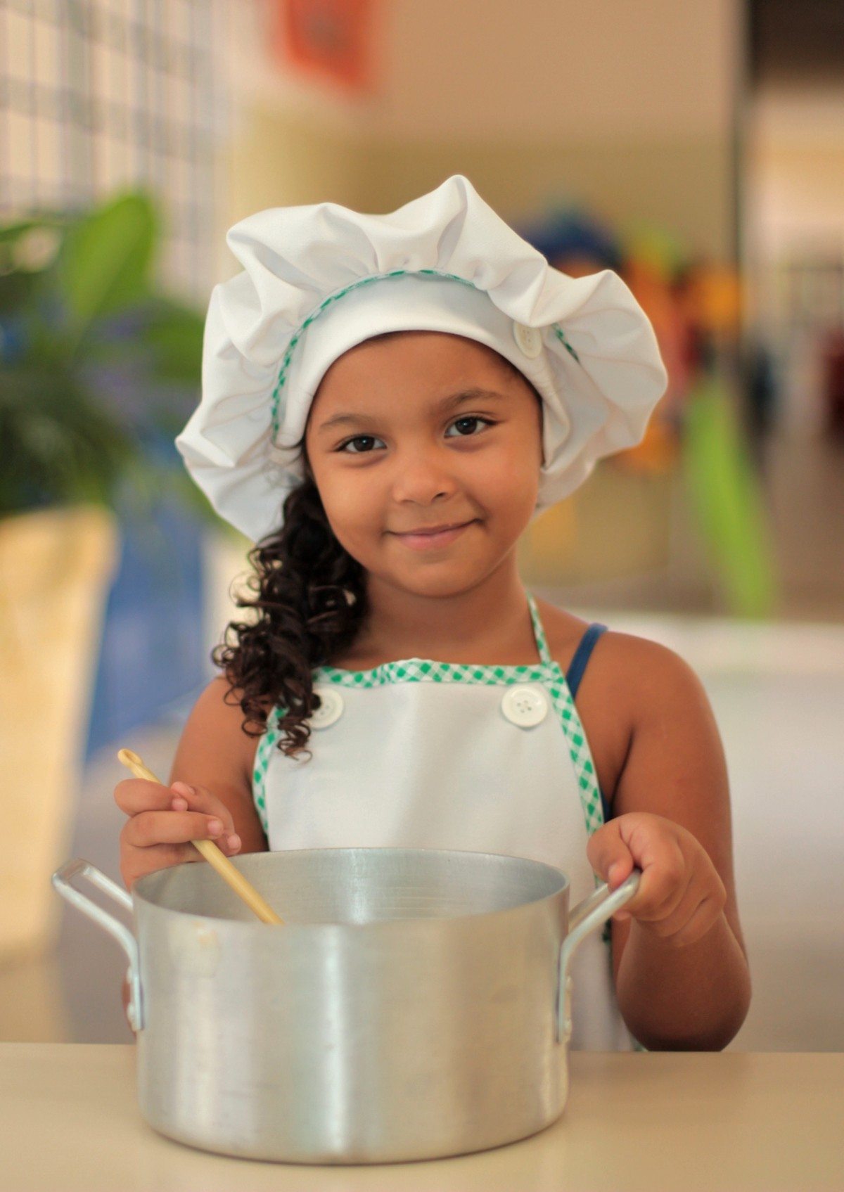
Arrangement
Included school subjects: science, food and health, social studies, Norwegian and mathematics.
Students found out what they knew about local ingredients from the sea.
Many questions arose and an idea-list was made.
The students interviewed family and locals in Risør.
They used their own experiences and their own curiosity to get ideas.
Students researched about the tolerability of the ingredients
Some of the recipes were tried out and collected in a cookbook.
Notes:
In this project the school has chosen to include the following subjects; science, food and health, social studies, Norwegian and mathematics.
Through conversations the students found out what they knew about local ingredients from the sea and the historical use of these ingredients.
The students interviewed family and locals in Risør to get old and new recipes with local ingredients that are rarely utilised in our days. They then researched about the tolerability of the ingredients and some recipes for it. Some of the recipes were tried out and collected in a cookbook.

Slide 37
Arrangement
Through practical exploratory fieldwork, students have become curious.
They have asked many questions and wondered what they have seen in practice.
Students have seen their own learning needs and based on that formulated their own questions and hypotheses.
Via textbooks, internet and through interviews, students have found answers to the questions they have had.
→ More information was also gathered by talking to the teacher ot to each other.
The students have worked a lot in learning pairs, both theoretically and practical.
At the end, the children have presented the results to each other in class.
Notes:
During the fieldwork activities, students have become curious and have asked many questions. Through textbooks, the internet, and interviews, they have found answers to the questions they had. In addition to asking their teachers, students also worked together in pairs. After their discussions, they presented their results to each other in class.

Slide 38
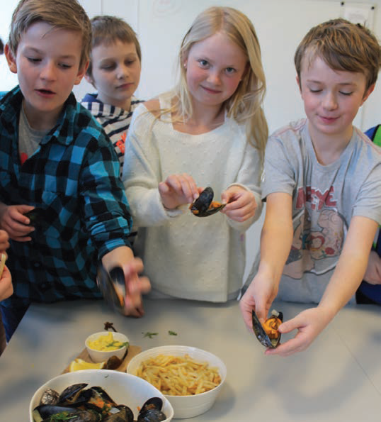
Learning Outcomes
Learnt about overfishing, unused resources, historical exploitation of marine resources, protection of endangered species.
Learnt about biological diversity and ecology in the sea.
Learnt that we be careful with use of nature, reduced pollution and harmful influences.
Learnt that the harvesting of natural resources must be done in a sensible and varied way.
Students experienced that there are many unused resources in the sea that we can reap from in a sustainable way
Notes:
Through this activity, students have learnt about overfishing but also unused or less used resources of the sea. They also learnt about historical exploitation of marine resources and the protection of endangered species. They also learnt about biological diversity and ecology in the sea, and that we should be careful of exploiting nature for our own benefit, and that harvesting of natural resources must be done in a sensible and varied way.

Slide 39
Mysen Skole
Gjøre naturfag! - økologisk skolehage og praktisk undervisning for bærekraftig utvikling
/ Making science! - ecological school garden and practical education for sustainable development

Slide 40
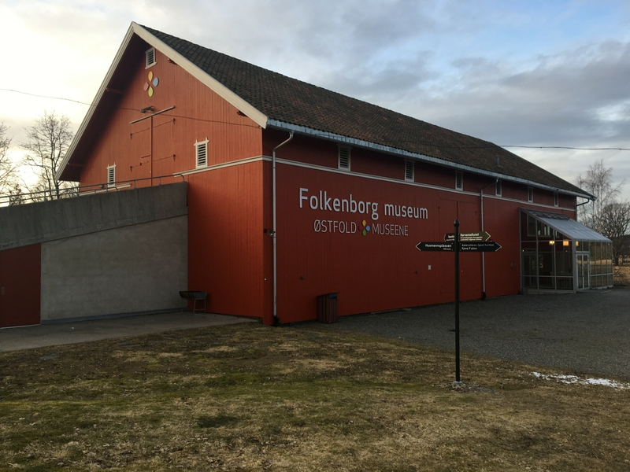
General information
Subjects
Natural sciences, food and health, Norwegian, social sciences, arts and crafts
Grade
5-6 grade
Arena
Schoolgarden at Folkenborg Museum
Classrooms of Mysen School
External competence
Employees of Folkenborg Museum
Notes:
This project included school subjects such as Natural Sciences, food and health, Social sciences, Norwegian and arts and crafts. It was implemented by 5 to 6 graders and took place in the classrooms and in the school garden of the Folkenborg museum. The project was supported by employees of Folkenborg museum.

Slide 41
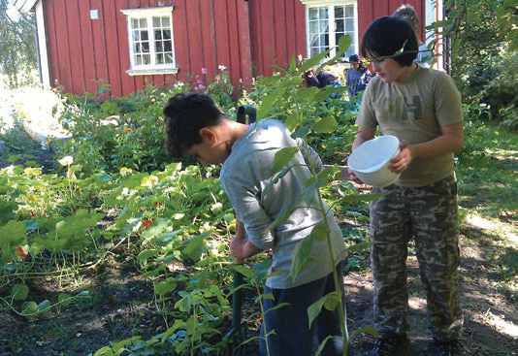
Project Description
- Students created a school garden in order to observe and understand the natural cycles.
- Students were sowing, harvesting, eating the produce, and composting the remains → understanding natural cycle
- Combined with theoretical education in the classroom
- Soil, compost and natural cycles were discussed
- PH-levels of soil were measured
Notes:
This project included school subjects such as Natural Sciences, food and health, Social sciences, Norwegian and arts and crafts. It was implemented by 5 to 6 graders and took place in the classrooms and in the school garden of the Folkenborg museum. The project was supported by employees of Folkenborg museum. The school created a school garden to observe and understand the natural cycles. By participating in sowing, harvesting, eating the produce, and composting the remains, the students gained a good understanding of the natural cycle.

Slide 42
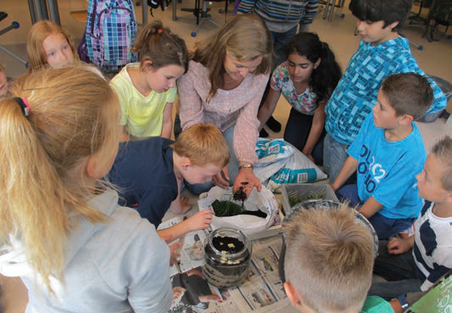
Project Activity
Students learnt aspects of food production and natural cycles
Project started early with theory and making compost in a bottle → then started creating the garden
Students prepared the soil for winter and took samples of the soil
Students sowed and made food from weeds that had to be removed.
Students harvested the vegetables and compared the taste to bought vegetables.
An important aspect of the work was allowing children to ask questions
Another important aspect was formulating their own explanations for what was happening.
More topics were discussed: decomposition and micro-organisms, the structure and needs of plants, a healthy diet, living a sustainable life.
Notes:
Students were exposed to questions surrounding the growth of food and were able to ponder many aspects of food production and natural cycles. The natural exposure to topics surrounding a garden let them observe, explore, and ask questions.
The project started early with theory and making compost in a bottle. They then started creating the garden. They prepared the soil for winter and took samples of the soil. thereafter, they sowed and made food from weeds that had to be removed. Finally, they harvested the vegetables and compared the taste to store bought vegetables.
An important aspect of the work was allowing children to ask questions and formulate their own explanations for what was happening.
The experiences made in the garden were brought into education in school. Here, the details surrounding soil, decomposition and micro-organisms, the structure and needs of plants, a healthy diet and discussing how to live a sustainable life.

Slide 43
Brønnerud Skole
Brønnerud skolehage
/ Brønnerud school garden

Slide 44

Participants
Brønnerud Skole (grades 1-7)
NMBU (university)
Vollebekk AS (local entrepreneur)
Stiftelsen Mavis (charitable society)
Notes:
Participants are the Brønnerud School, particularly grades 1 to 7. Additionally the Norges Miljø- og biovitenskapelige universitet assisted the project as well. Other participants are the local company Vollebekk AS and Stiftelsen Mavis.

Slide 45
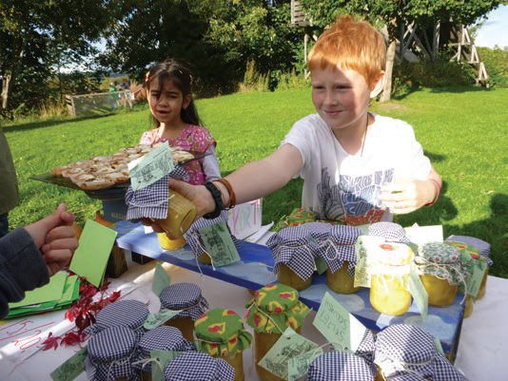
Project Background
Students can grow vegetables and sell them on the weekly market
The profits go to a solidarity project in Zimbabwe (orphanage)
Students participate in school garden work, market and solidarity work
Emphasis of this project --> collaboration amongst different actors
External actors contribute with professional and practical competence and with materials and equipment.
Students gain understanding of sustainable development and helps to
Students are teached to become more responsible environmental citizens
The project stimulates creativity, commitment, engagement and good attitudes in children
Notes:
Participants are the Brønnerud School, particularly grades 1 to 7. Additionally the Norges Miljø- og biovitenskapelige universitet assisted the project as well. Other participants are the local company Vollebekk AS and Stiftelsen Mavis.

Slide 46
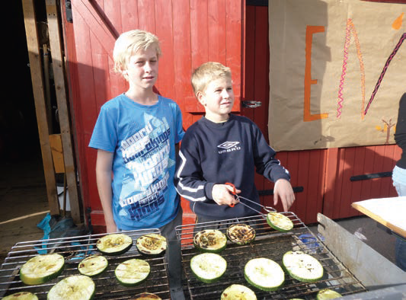
The Project
Students grew vegetables and learned about the cycle of nature, biological diversity and about composting
Students identified and classified plants and insects that we found
Developed products for sale on the market
The profit from the market goes to a solidarity project in Zimbabwe
Notes:
Participants are the Brønnerud School, particularly grades 1 to 7. Additionally the Norges Miljø- og biovitenskapelige universitet assisted the project as well. Other participants are the local company Vollebekk AS and Stiftelsen Mavis.

Slide 47
Lauvsnes Skole
Lauvsnes skolehage
/ Lauvsnes school garden

Slide 48
Key Actors
1-10th grade at Lauvsnes Skole
Vangan Kindergarten
Flatanger Nursing Homes
A Local Horse Stable
Bjørøya Fish-farming
Trønderelement (construction firm)
Lauvsnes Skole

Slide 49
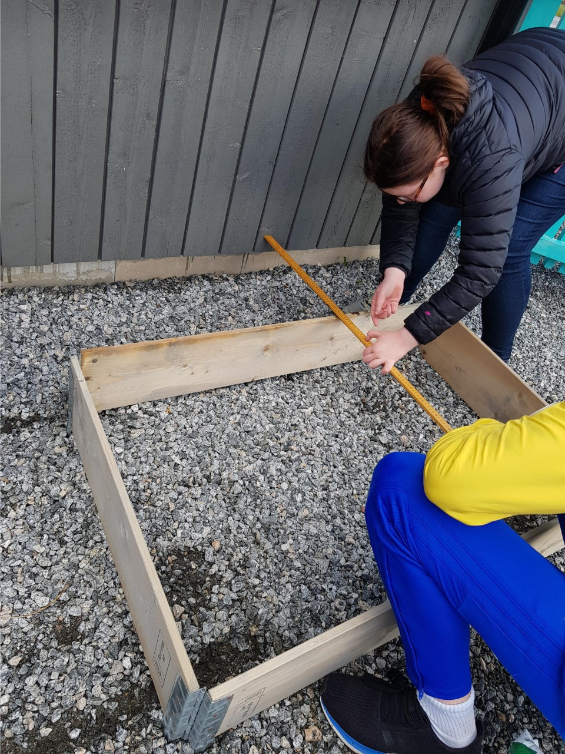
Description
Emphasis on local resources.
Garden boxes made from material by local businesses. Filled with soil from construction site.
Horse fertiliser from local stable.
Lauvsnes Skole

Slide 50
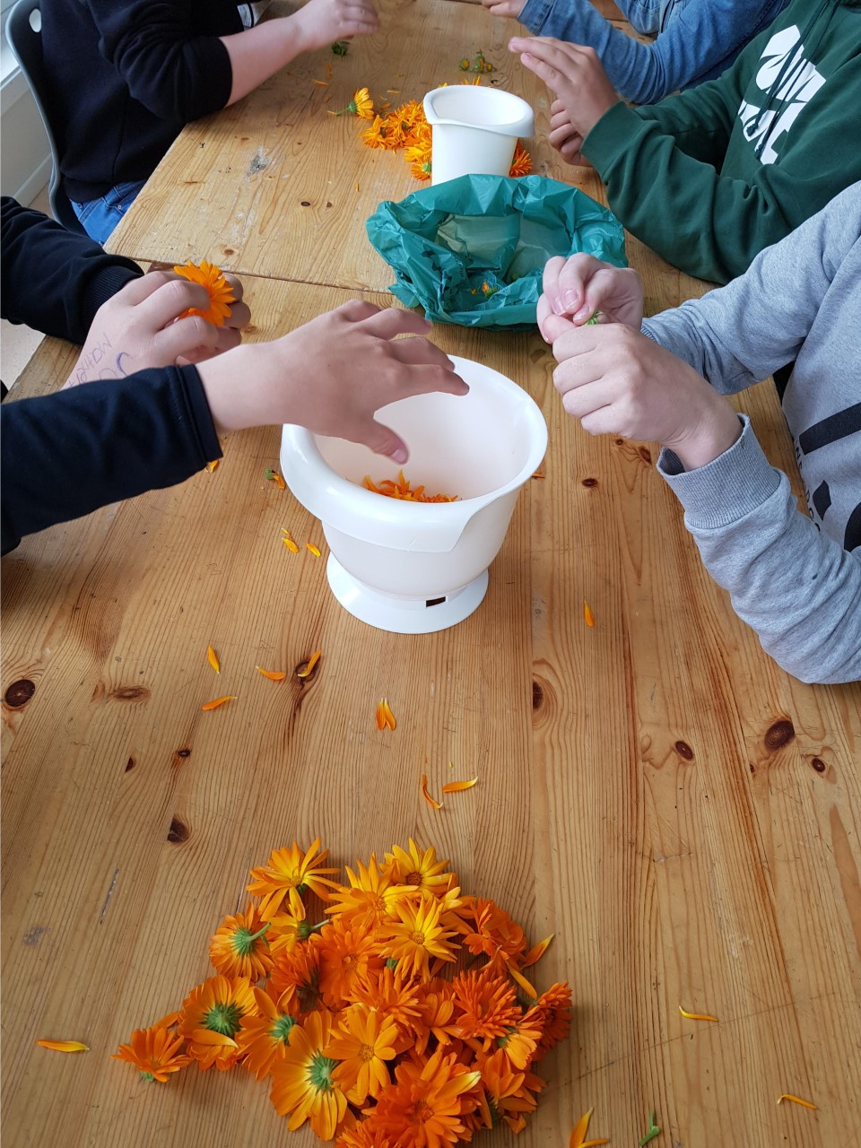
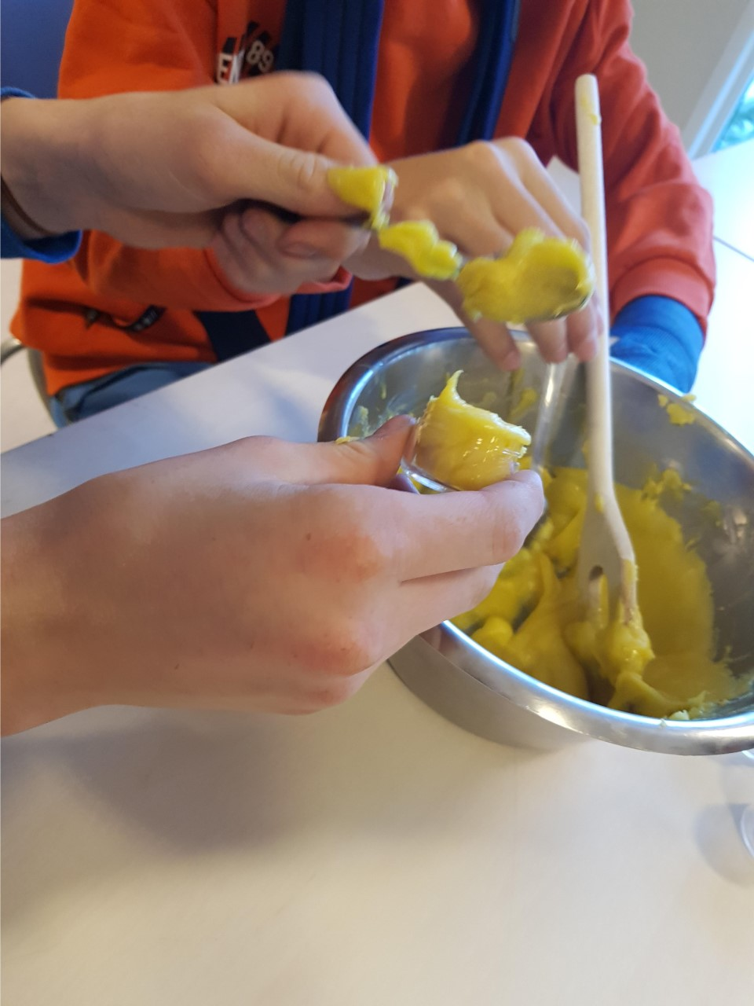
Description
Have planted summer flowers and vegetables
Summer flowers have been turned into balm and sold with profit
They are in talks with gardening centre as a way to expand
Lauvsnes Skole

Slide 51
Vestmyra Skole
Det myldrende livet i fjæra på Lund og Klungset
/ The bustling life on the shore of Lund and Klungset

Slide 52



General information
Subjects:
Natural Science, Social Science, Maths, PE, Norwegian
Grade:
7. and 9. Grade
Learning arena
classroom, school lab, excursion area at Lund/Erikstadfjæra
External competence
Statskog Fauske, Norges naturvernforbund-Nordland, Forum for natur og friluftsliv, Norges jeger- og Fiskerforbund-Nordland
Notes:
This project included school subjects such as Natural Sciences, Social Sciences, Maths, Physical Education, Norwegian. It was implemented by 7 to 9 graders and took place in the classroom, the school labs and in the Lund/Erikstadfjæra area.
This project was supported by several organisations such as Statskog Fauske, Norges naturvernforbund-Nordland, Forum for natur og friluftsliv, Norges jeger- og Fiskerforbund-Nordland.

Slide 53
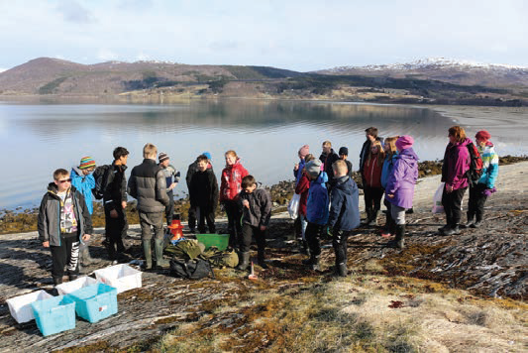
The Project
Students studied what sustainable development means and learnt practical examples of these
Students gathered information and formulated hypotheses
During field work students measured PH-levels, temperature and salt levels in water
Students mapped biological biodiversity → observed and registered birdlife in the area
In the final phase, they systematised and worked the data and observations.
Students made reports and presented them using various digital tools.
Notes:
This project included school subjects such as Natural Sciences, Social Sciences, Maths, Physical Education, Norwegian. It was implemented by 7 to 9 graders and took place in the classroom, the school labs and in the Lund/Erikstadfjæra area.
This project was supported by several organisations such as Statskog Fauske, Norges naturvernforbund-Nordland, Forum for natur og friluftsliv, Norges jeger- og Fiskerforbund-Nordland.

Slide 54
Dyrk Framtida
Cultivate the future

Slide 55

Participants
Økologisk Norge - Ecological Norway, a non-profit membership-based organization
  Funding from the charitable fund “Sparebankstiftelsen DNB”
Notes:
The Kråkerøy school garden was established in 2018 as a part of Fredrikstad municipality’s political goal of establishing access to school gardens for every school child. The project got money from sparebankstiftelsen DNB (a foundation giving money to charity), Fredrikstad municipality’s climate fund and innovation fund and Kråkerøy local community panel.

Slide 56
The Project
Establishing New School Gardens
  School gardens were for the last 30 years de-prioritised in Norway
  Farming, nature and biodiversity as counters to climate change
Helps create 10 school gardens every year
  Project to help create 40 School gardens
  Created in Eastern Norway
Establishing networks and resource libraries
  Mapping school gardens
  Informal facebook group
  Library for information
Notes:
The Kråkerøy school garden was established in 2018 as a part of Fredrikstad municipality’s political goal of establishing access to school gardens for every school child. The project got money from sparebankstiftelsen DNB (a foundation giving money to charity), Fredrikstad municipality’s climate fund and innovation fund and Kråkerøy local community panel.

Slide 57
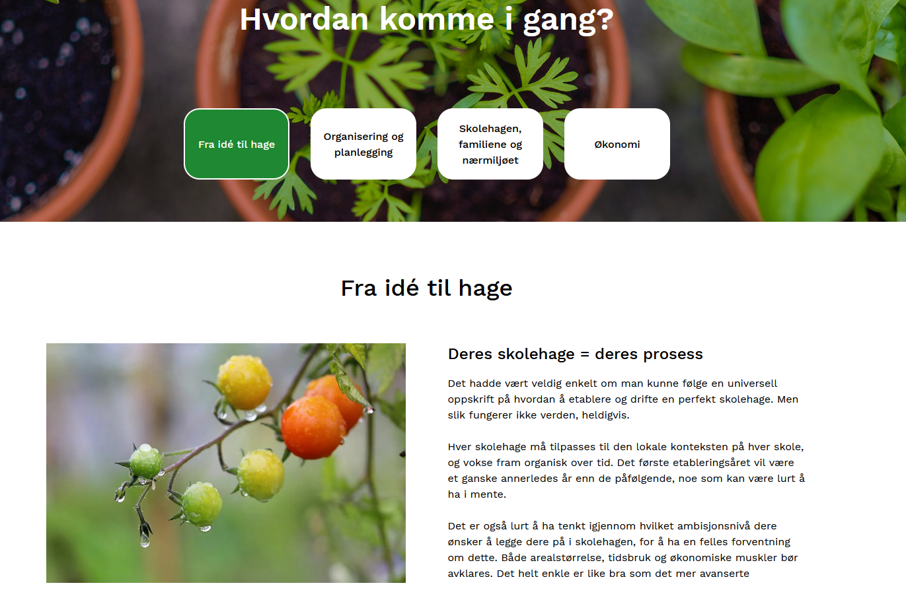
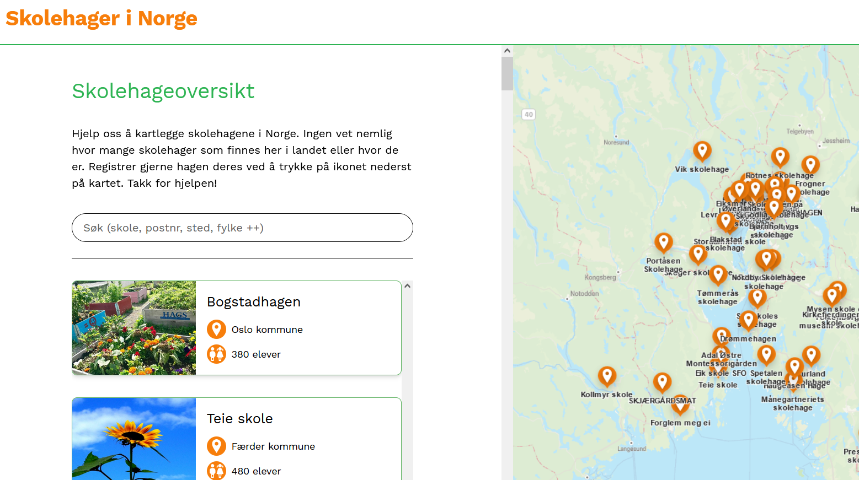
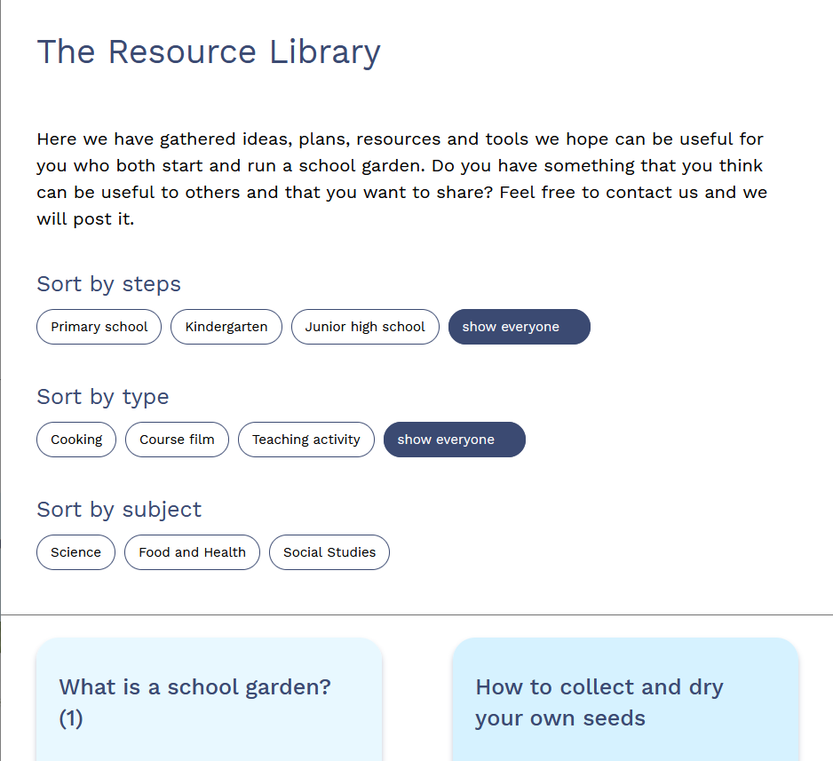
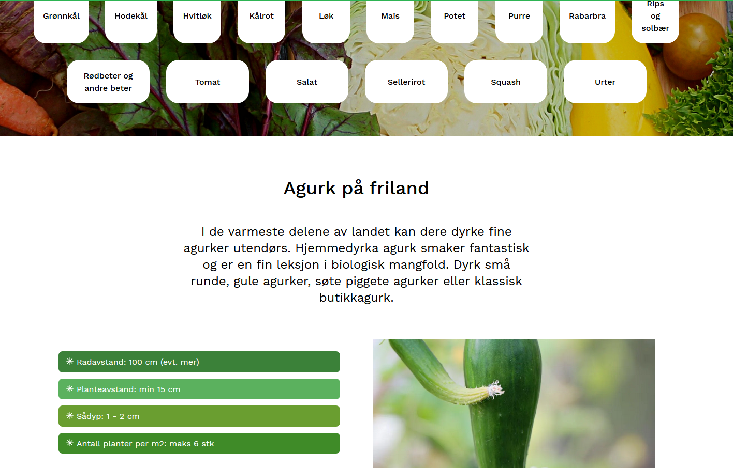

The 4 Main focuses of the DF website
Guide on how to establish a school garden
Overview of school gardens in Norway
Resource library
(translated from Norwegian)
Cultivation
Guide
Notes:
The most comprehensive and interesting aspect of Dyrk Framtida is their website and the variety of resources they provide on it. Their website is built in a simple manner with 4 main links.
The first leads to a resource which explains the steps to create a school garden. This includes a checklist for organisation and establishment, how to divide responsibility and put aside the time to create the school garden, how to involve the local community along with a recommendation for actors to involve ranging from family to local businesses, what to do over the summer vacation, and how to finance the project. The final page includes where to apply for support and what costs money in the creation of a school garden.
The second link leads to a resource library of ideas, activities, resources and tools that can help in the establishment and day-to-day running of a school garden. The library contains information like how to collect and dry seeds, an introduction to ecological farming, a to-do list for sustainable school gardens, tools and a variety of projects with detailed descriptions. As part of this initiative, Dyrk framtida seeks to expand the library and has included an encouragement to send in any projects that school gardens have begun.
The third link leads to an overview of school gardens in Norway. This overview is volunteer based and seeks to create a simple library of school gardens with name, description, location and contact information. To be included in this database the schools have to fill out a simple form and will then be included in the database after confirmation from Dyrk Framtida.
The final link is a cultivation guide. Seeking to be completed by the spring of 2022, it currently includes over 25 vegetables, berries and fruit. The guide provides thorough descriptions of how and when to sow, grow and harvest them, how much water they need and what kind of fertiliser is good. Finally they add some useful tips to help the growth of the plants. Like the rest of Dyrk Framtida’s resources, this seeks to be an ever-expanding source of knowledge.

Slide 58
The 4 Main focuses of the DF website
How to establish a school garden
  Step by step explanation of establishment
  Checklists
  Organisation of staff
  What actors to include
  economy
Resource Library
  Ideas and activities
  Resources and tools
  Sorted by grade, category and course
  Ever expanding
Overview of school gardens
  Volunteer based
    Simple form
  Name, description, location and contact information
  Interactive map
  Search feature
Cultivation guide
  25 vegetable, fruits and berries
  Description of how and when to:
    Sow
    Grow
    Harvest
    Water
    Fertilise
Notes:
The most comprehensive and interesting aspect of Dyrk Framtida is their website and the variety of resources they provide on it. Their website is built in a simple manner with 4 main links.
The first leads to a resource which explains the steps to create a school garden. This includes a checklist for organisation and establishment, how to divide responsibility and put aside the time to create the school garden, how to involve the local community along with a recommendation for actors to involve ranging from family to local businesses, what to do over the summer vacation, and how to finance the project. The final page includes where to apply for support and what costs money in the creation of a school garden.
The second link leads to a resource library of ideas, activities, resources and tools that can help in the establishment and day-to-day running of a school garden. The library contains information like how to collect and dry seeds, an introduction to ecological farming, a to-do list for sustainable school gardens, tools and a variety of projects with detailed descriptions. As part of this initiative, Dyrk framtida seeks to expand the library and has included an encouragement to send in any projects that school gardens have begun.
The third link leads to an overview of school gardens in Norway. This overview is volunteer based and seeks to create a simple library of school gardens with name, description, location and contact information. To be included in this database the schools have to fill out a simple form and will then be included in the database after confirmation from Dyrk Framtida.
The final link is a cultivation guide. Seeking to be completed by the spring of 2022, it currently includes over 25 vegetables, berries and fruit. The guide provides thorough descriptions of how and when to sow, grow and harvest them, how much water they need and what kind of fertiliser is good. Finally they add some useful tips to help the growth of the plants. Like the rest of Dyrk Framtida’s resources, this seeks to be an ever-expanding source of knowledge.

Slide 59
Kråkerøy Skole
Kråkerøy Skolehage /
Kråkerøy School Garden

Slide 60
Participants
Kråkerøy Ungdomsskole
Sparebankstiftelsen DNB
Fredrikstad municipality’s climate fund
Fredrikstad municipality’s innovation fund
Local community of Kråkerøy
Farmers from three neighbouring farms
Beekeeper paid by the Norsk Birøkterlag
Three local primary schools
Three local kindergartens
Notes:
The Kråkerøy school garden was established in 2018 as a part of Fredrikstad municipality’s political goal of establishing access to school gardens for every school child. The project got money from sparebankstiftelsen DNB (a foundation giving money to charity), Fredrikstad municipality’s climate fund and innovation fund and Kråkerøy local community panel.

Slide 61
School Subjects
Elective course “cultural heritage”
“Food and health”
used in any course where it is believed to be useful
Grades 8 to 10
Notes:
The Kråkerøy school garden was established in 2018 as a part of Fredrikstad municipality’s political goal of establishing access to school gardens for every school child. The project got money from sparebankstiftelsen DNB (a foundation giving money to charity), Fredrikstad municipality’s climate fund and innovation fund and Kråkerøy local community panel.

Slide 62
The Project
Two vegetable fields (400 m2), a greenhouse, a hen house, an apple garden and a bee farm
Hen house runs on photovoltaic electricity
Potatoes, pumpkins, onions and sunflowers.
→ The vegetables and eggs are used in the food and health course.
Agreement with a beekeeper from “Norsk Birøkterlag”, a national beekeeping association.
Get help from young employed people, as part of social security
Get help from three local farms to plough and fertilise the fields
Notes:
The Kråkerøy school garden was established in 2018 as a part of Fredrikstad municipality’s political goal of establishing access to school gardens for every school child. The project got money from sparebankstiftelsen DNB (a foundation giving money to charity), Fredrikstad municipality’s climate fund and innovation fund and Kråkerøy local community panel.

Slide 63
The Project
Purpose is to teach students how to farm vegetables in an ecological and sustainable way.
Keeping of hens allows the school to teach about animal welfare and egg- and chicken production
Beekeeping allows children to be taught about insects, pollination and their importance in biological diversity
→ throughout these lessons, students gain a better understanding of sustainable choices
and the ability to create food for oneself
Notes:
The Kråkerøy school garden was established in 2018 as a part of Fredrikstad municipality’s political goal of establishing access to school gardens for every school child. The project got money from sparebankstiftelsen DNB (a foundation giving money to charity), Fredrikstad municipality’s climate fund and innovation fund and Kråkerøy local community panel.

Slide 64
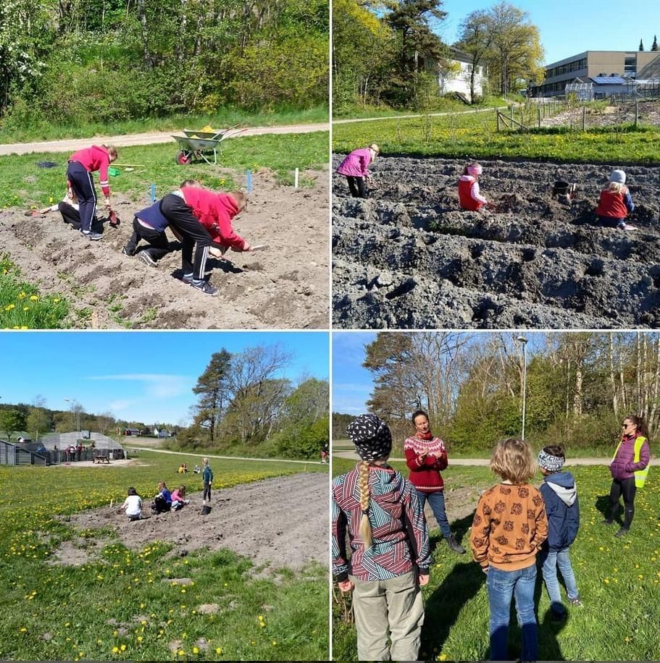
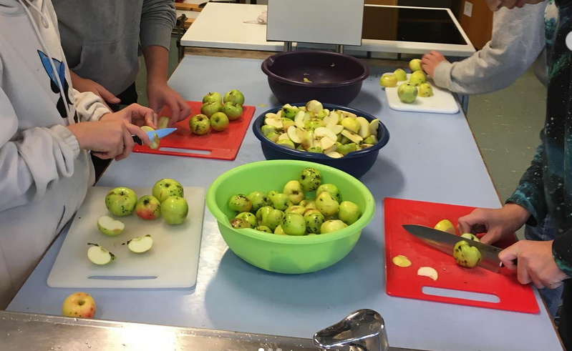

Slide 65
Son Skole
Son Skolehage /
Son School Garden

Slide 66
Participants
Grade 1-7 of Son Skole
Son seed library
Skøien Farm
Norwegian University of life sciences
Vitenparkens (the knowledge park) school department
Grønt flagg, an environmental certification for schools and gardens
Vestby Municipality
Movar, drainage, renovation and Fire and rescue
Notes:
The Kråkerøy school garden was established in 2018 as a part of Fredrikstad municipality’s political goal of establishing access to school gardens for every school child. The project got money from sparebankstiftelsen DNB (a foundation giving money to charity), Fredrikstad municipality’s climate fund and innovation fund and Kråkerøy local community panel.

Slide 67
The Project
Elective course “cultural heritage”
“Food and health”
used in any course where it is believed to be useful
Grades 8 to 10
Notes:
The Kråkerøy school garden was established in 2018 as a part of Fredrikstad municipality’s political goal of establishing access to school gardens for every school child. The project got money from sparebankstiftelsen DNB (a foundation giving money to charity), Fredrikstad municipality’s climate fund and innovation fund and Kråkerøy local community panel.

Slide 68
Project Activities
Set off an area where they have planted garden boxes
Sowing seeds in every classroom
sow a variety of vegetables in the garden
Create a variety of nature-supporting projects including Hedgehog-houses, insect-hotels, birdhouses, and terrariums.
Create compost, both “warm composting” and “Bokashi”
Notes:
The Kråkerøy school garden was established in 2018 as a part of Fredrikstad municipality’s political goal of establishing access to school gardens for every school child. The project got money from sparebankstiftelsen DNB (a foundation giving money to charity), Fredrikstad municipality’s climate fund and innovation fund and Kråkerøy local community panel.

Slide 69
NBS Projects Outside Schools

Slide 70
Bee Housing

Slide 71
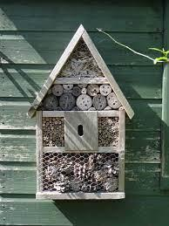

The Project
Building bee housing with recyclable materials
Simple and fun activity for children to preserve bee hives
Campaign started by Sunniva, a Norwegian juice company
Notes:
The Kråkerøy school garden was established in 2018 as a part of Fredrikstad municipality’s political goal of establishing access to school gardens for every school child. The project got money from sparebankstiftelsen DNB (a foundation giving money to charity), Fredrikstad municipality’s climate fund and innovation fund and Kråkerøy local community panel.

Slide 72
Bykuben, Oslo

Slide 73
The Project
Green urban ecological project aiming to balance nature and human activity
Aims to reach Oslo inhabitants, cooperating with its districts and municipal enterprises
Project “Oslotrær” plans to plant 100,000 trees in the city by year 2030
Notes:
The Kråkerøy school garden was established in 2018 as a part of Fredrikstad municipality’s political goal of establishing access to school gardens for every school child. The project got money from sparebankstiftelsen DNB (a foundation giving money to charity), Fredrikstad municipality’s climate fund and innovation fund and Kråkerøy local community panel.

Slide 74
Kompostringen, Bergen

Slide 75
The Project
An initiative by Bybonden (city farmer) and Lystgården
Citizens can stop by and drop off food waste to get composted soil in return, or donate them to local farmers
Notes:
The Kråkerøy school garden was established in 2018 as a part of Fredrikstad municipality’s political goal of establishing access to school gardens for every school child. The project got money from sparebankstiftelsen DNB (a foundation giving money to charity), Fredrikstad municipality’s climate fund and innovation fund and Kråkerøy local community panel.

Slide 76
Opening Water Streams,Trondheim

Slide 77
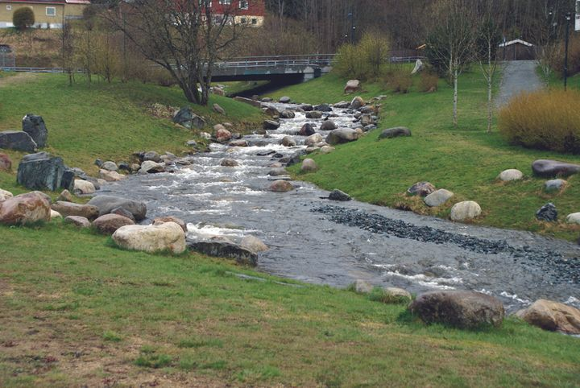
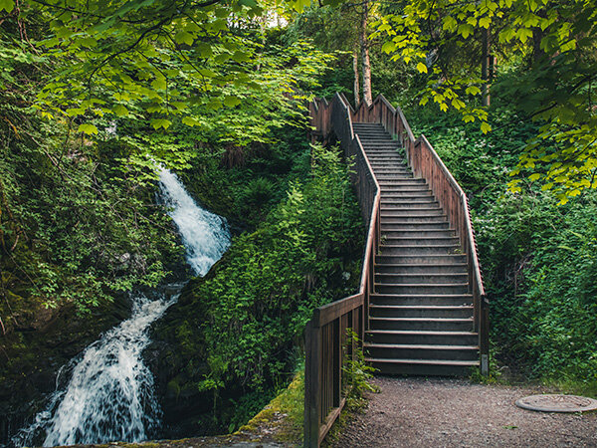
The Project
In collaboration with SINTEF’s Klima 2050
Provides a recreational area while also providing better pre-conditions for changed rainfall patterns
Notes:
The Kråkerøy school garden was established in 2018 as a part of Fredrikstad municipality’s political goal of establishing access to school gardens for every school child. The project got money from sparebankstiftelsen DNB (a foundation giving money to charity), Fredrikstad municipality’s climate fund and innovation fund and Kråkerøy local community panel.

Slide 78
Tenk Tre
Think Tree

Slide 79
The Project
Tenk Tre directly translates to "Think wood" and is an industry initiative from a number of companies and organizations within the Norwegian forest and wood industry.
Undertakes a lot of initatives, ex. National tree planting day for children in Spring 2021 to enhance local forests
5th grade - 6th grade students
Notes:
The Kråkerøy school garden was established in 2018 as a part of Fredrikstad municipality’s political goal of establishing access to school gardens for every school child. The project got money from sparebankstiftelsen DNB (a foundation giving money to charity), Fredrikstad municipality’s climate fund and innovation fund and Kråkerøy local community panel.

Slide 80
Losæter Urban Garden, Oslo

Slide 81
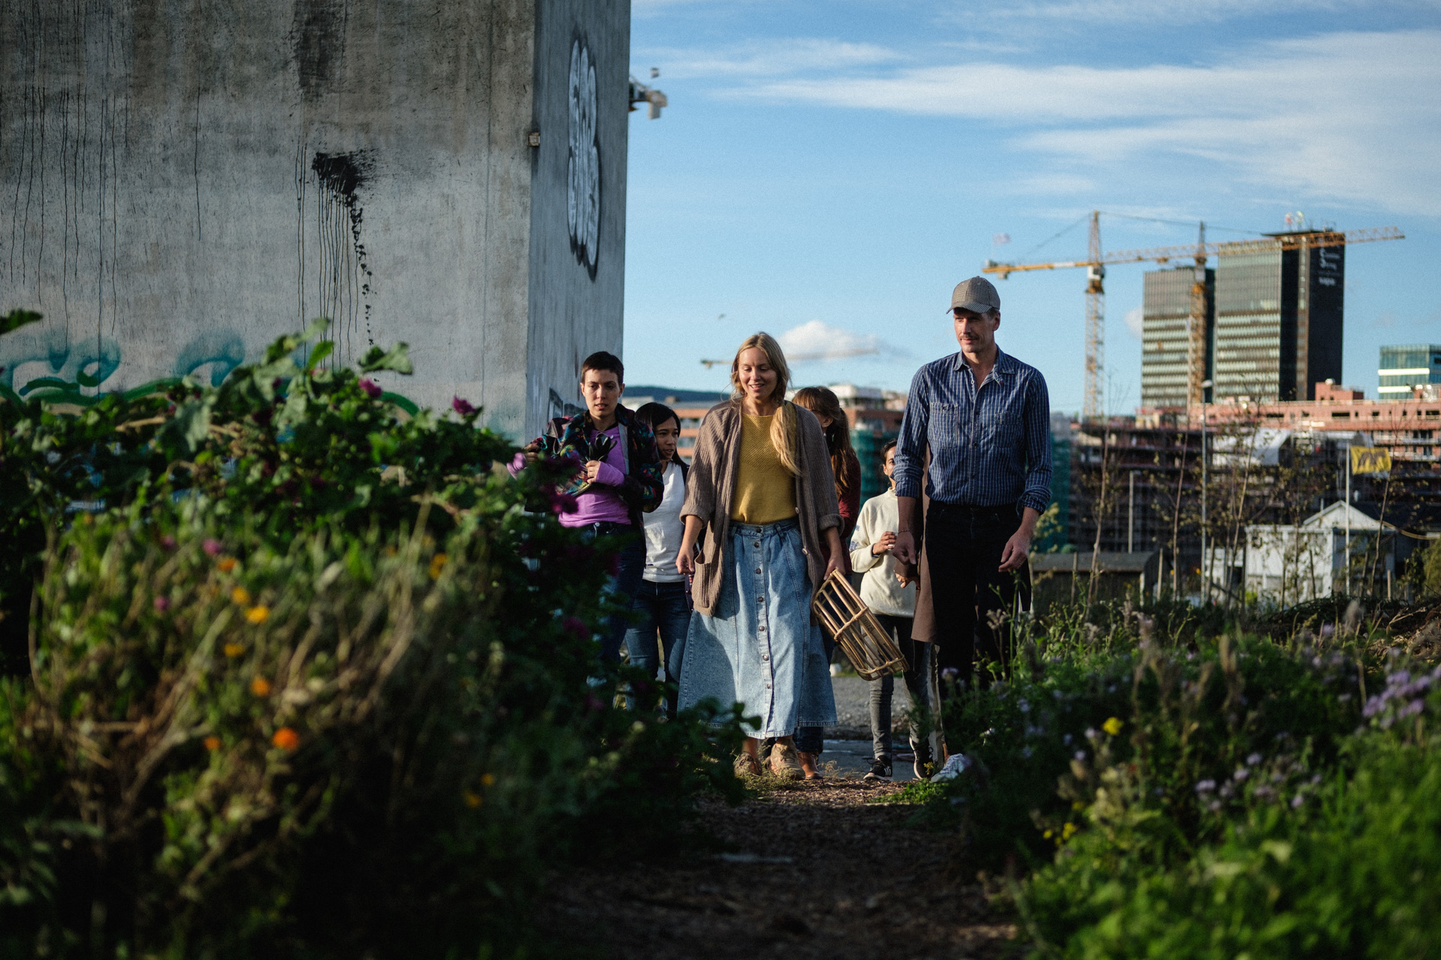
The Project
Established in 2011 as an art project
Today consists of fields with traditional grains and vegetables, and:
  Living soil
  Compost
  Pallet collars
  A public baking house
  A horticultural therapy project
  Activities, events, and festivals,
  The cabin as a place for meetings and lunch break
  Orchard, beehives, and a birdhouse
  A large greenhouse
  A compost toilet
Notes:
The Kråkerøy school garden was established in 2018 as a part of Fredrikstad municipality’s political goal of establishing access to school gardens for every school child. The project got money from sparebankstiftelsen DNB (a foundation giving money to charity), Fredrikstad municipality’s climate fund and innovation fund and Kråkerøy local community panel.

Slide 82
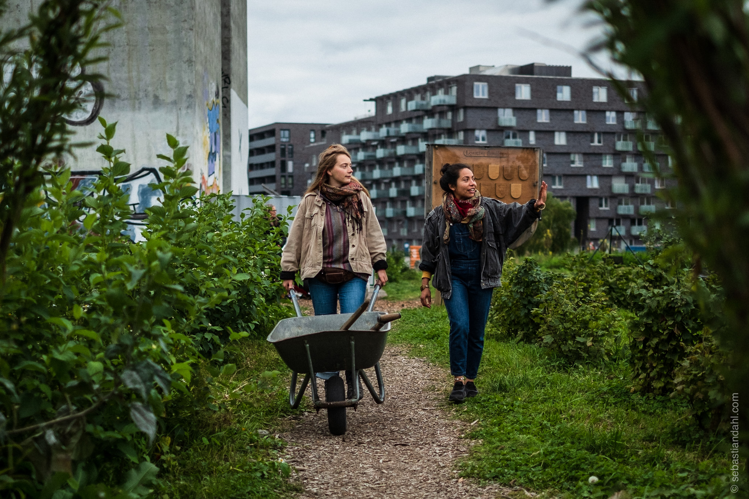
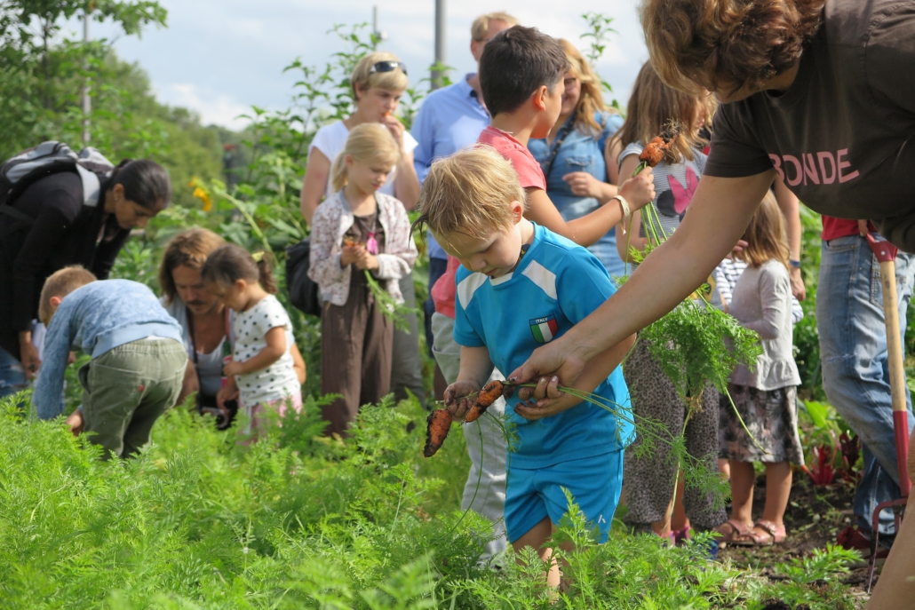
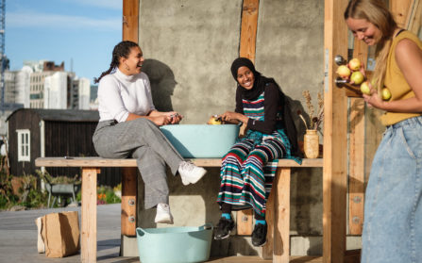

Slide 83
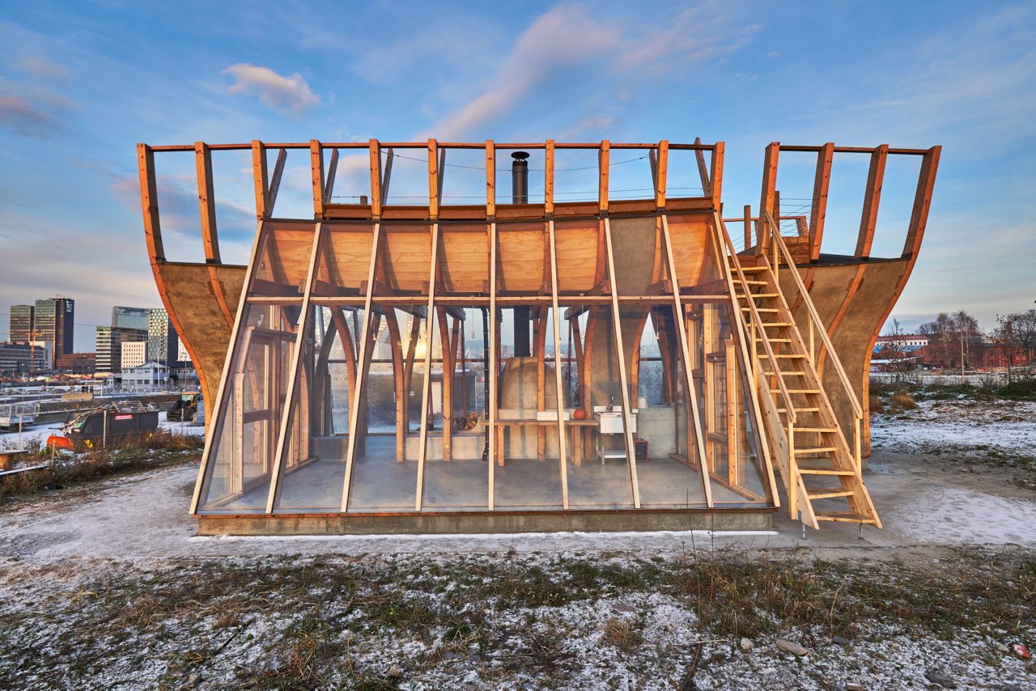
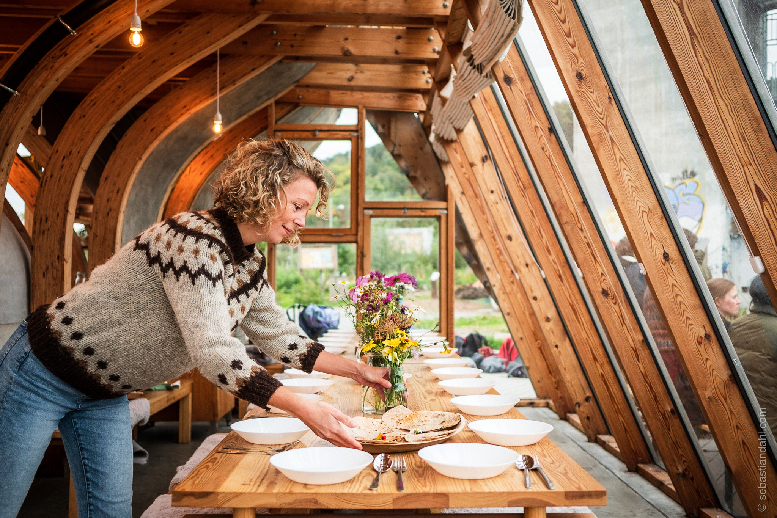

Slide 84
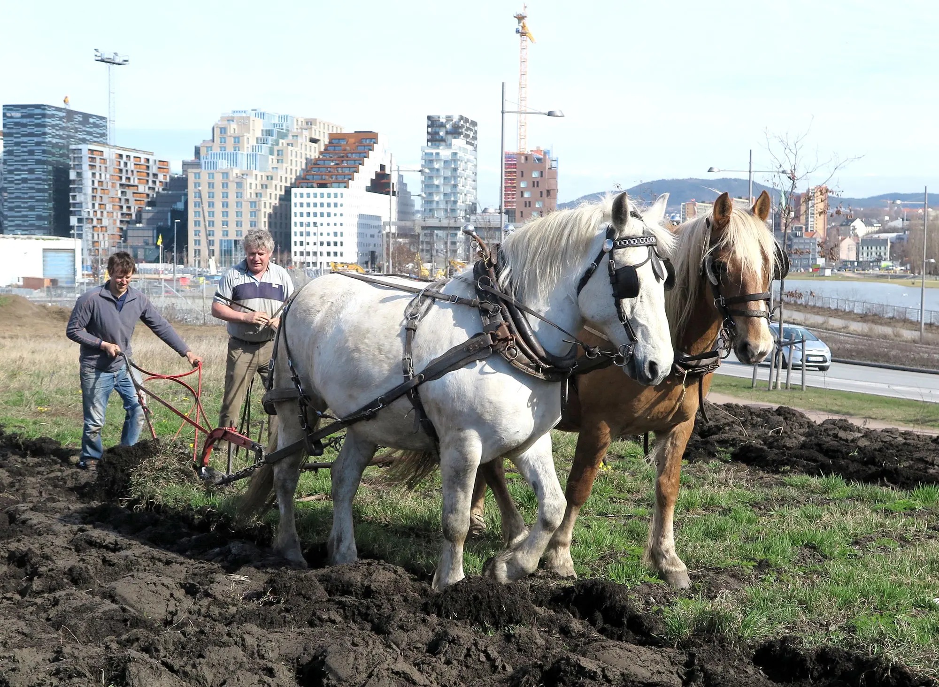

Slide 85

Dziękuję za uwagę!
Projekt powstał w ramach programu Środowisko, Energia i Zmiany Klimatu. Dofinansowanie pochodzi ze środków Mechanizmu Finansowego Europejskiego Obszaru Gospodarczego 2014-2021 oraz budżetu państwa. Projekt realizuje Obszar Metropolitalny Gdańsk-Gdynia-Sopot we współpracy z partnerem merytorycznym Gdańskie Wody oraz partnerem zagranicznym International Development Norway.

